Slide 1

Netflix challenge
Information retrieval & data mining
Robin De Haes
Mathias Mallinus

Slide 2
The Netflix challenge dataset

Slide 3
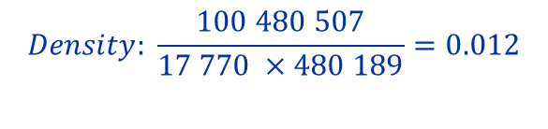
dataset overview
sparsity
 | Minimum | Maximum | # Distinct Entries
Movie ID | 1 | 17 770 | 17 770
User ID | 1 | 2 649 429 | 480 189
Rating | 1 | 5 | 100 480 507
$$Density: \frac{100 480 507}{17 770 ×480 189}=0.012$$
Notes:
- Movie ID: sequential - User ID: non-sequential, gaps
- Rating: integers from 1 to 5
- High sparsity (only 1% of entries is filled)

Slide 4
dataset
format
4 text files
MovieID1:
CustomerID11,Rating11,Date11
CustomerID12,Rating12,Date12
...
MovieID2:
CustomerID21,Rating21,Date21
CustomerID22,Rating22,Date22
Notes:
Dataset given in this format, so we need some custom parsing

Slide 5
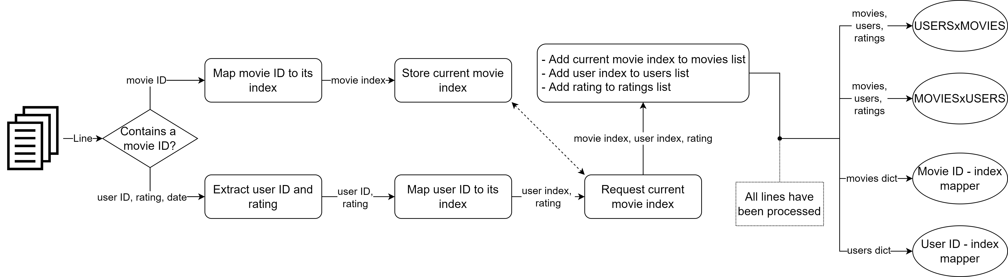
Loading the dataset
Parsing pipeline
Notes:
If we encounter a movie ID, we keep track of which movie this is so we know al subsequent user/rating lines have to do with this movie
We store the movie, user and rating in lists on the same index so the i-th index represent the rating by that user for that movie
Once everything is processed, we can use these lists to make the matrices
Important note is that we also return a bidirectional mapper: * movieIDs and userIDs are mapped to an incrementing index which represents their index in the sparse matrix so the IDs don’t have to be integers
* in-order storage of Python dict allow to take list of keys and also go back from matrix indices to the Ids
- We also allow random emission of a percentage of the ratings for debugging purposes (to be able to work with smaller matrices)

Slide 6
Splitting the dataset
Probe file
1 probe file
MovieID1:
CustomerID11
CustomerID12
...
MovieID2:
CustomerID21
CustomerID22
Notes:
In-sample training error cannot reliably be used to obtain generalization, so we also split out dataset for our experiments
One method was based on the provided probe file which has entries identifying a test partition of the full dataset
We use our mapper from the pipeline to transform these entries to indices in the full sparse matrix and create a test mask based on it

Slide 7
Splitting the dataset
Probe mask
Original Sparse Matrix
 | 1 | 2 | 3 | … | 480189
1 | 1 | 5 | 4
2 |  | 2 | 1 |  | 2
3 |  |  | 1
… | 3
17769 |  | 3
17770 |  |  | 1
Index-based Mask
 | 1 | 2 | 3 | … | 480189
1 |  | 1
2 |  | 1 |  |  | 1
3
…
17769
17770 |  |  | 1
Notes:
Test matrix is obtained by creating a mask and then performing multiplication
Training matrix is then obtained by difference between original matrix and the test matrix

Slide 8
Splitting the dataset
probe overview
 | # Movie IDs | # User IDs | # Ratings | % of Full Dataset
Training | 17 770 | 480 189 | 9 907 112 | 98.6
Test | 16 938 | 462 858 | 1 408 395 | 1.4
Full | 17 770 | 480 189 | 100 480 507 | 100
Notes:
The training set we obtain this way is only 1% of the original dataset which is low, but it has broad coverage of users and movie IDs. In the end it’s also still 1 million samples due to the dataset size and it is provided by the creators so we mostly used this set for testing.

Slide 9
Splitting the dataset
Random sampling
Original Sparse Matrix
 | 1 | 2 | 3 | … | 480189
1 | 1 | 5 | 4
2 |  | 2 | 1 |  | 2
3 |  |  | 1
… | 3
17769 |  | 3
17770 |  |  | 1
Test Sparse Matrix
 | 1 | 2 | 3 | … | 480189
1 |  | 5
2 |  | 2 |  |  | 2
3
…
17769
17770 |  |  | 1
Notes:
However, we also provided a more traditional train-test split method that simply takes a specified percentage of entries from the original matrix to use as test set. The training set is again obtained by computing the difference.

Slide 10
dimsum

Slide 11
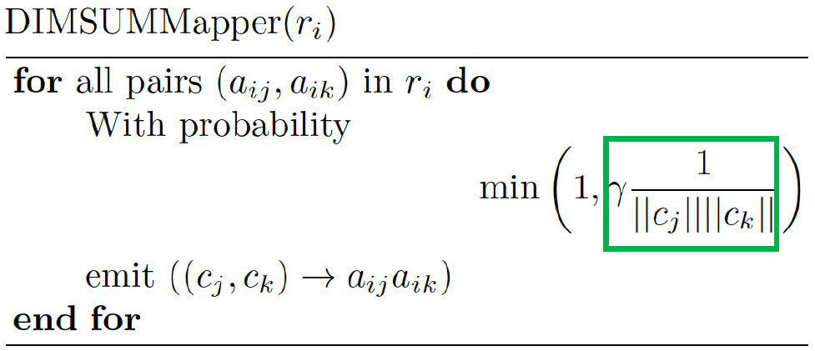
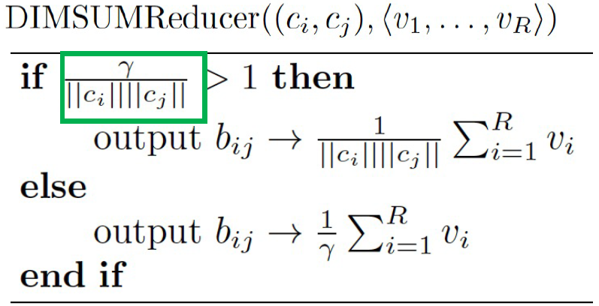
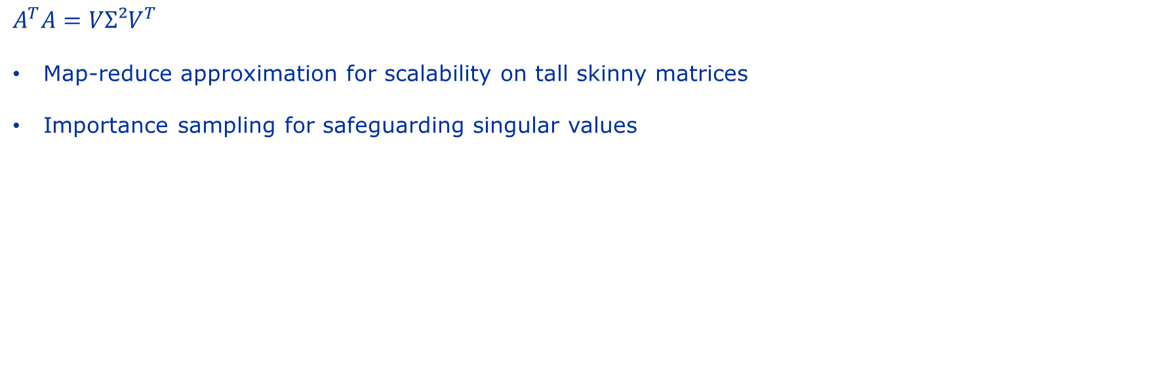
Singular value decomposition
Dimsum approach
$$A^{T}A=VΣ²V^{T}$$
Map-reduce approximation for scalability on tall skinny matrices
Importance sampling for safeguarding singular values
Notes:
DIMSUM is used to approximate AT.A which takes a central position in the SVD decomposition
Distributed mapper operations for each row makes this ideal for tall skinny matrices such as the USER x MOVIES matrix
Importance sampling based on cosine similarities. These similarities can be exploited since highly popular columns should be sampled less as a small sample of them can already hold enough information
We will mostly focus on the impact of gamma, the parameter modulating sampling behavior
Higher values for gamma will lead to more emissions and better approximations but more communication costs and reduce-key complexity.
Two remarks: we don’t use HADOOP so we used a smaller dataset namely the probe test set highest gamma that is useful is the square of the largest column norm because that would lead to full emission and an exact computation (for which the error should be 0)

Slide 12
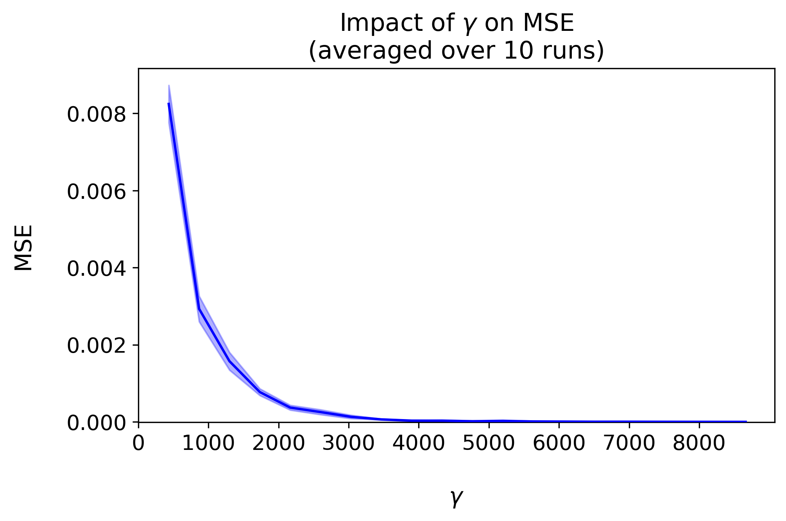
DIMSUM
Impact of γ
Notes:
We researched 20 values for gamma and as you can see
- Clear downward trend
Lower gamma means less sampling, so more variance and more errors
At a certain point with high enough gamma, the error effectively becomes 0
Remark:
All MSE values are quite low but this is because we’ve scaled our entries as this was also done in the paper (although this did not seem to influence the result) + probe test set is very sparse and zero-entries in AT.A don’t need emission to be correct (since they’re zero), so in effect we’re dividing the MSE by a constant factor

Slide 13
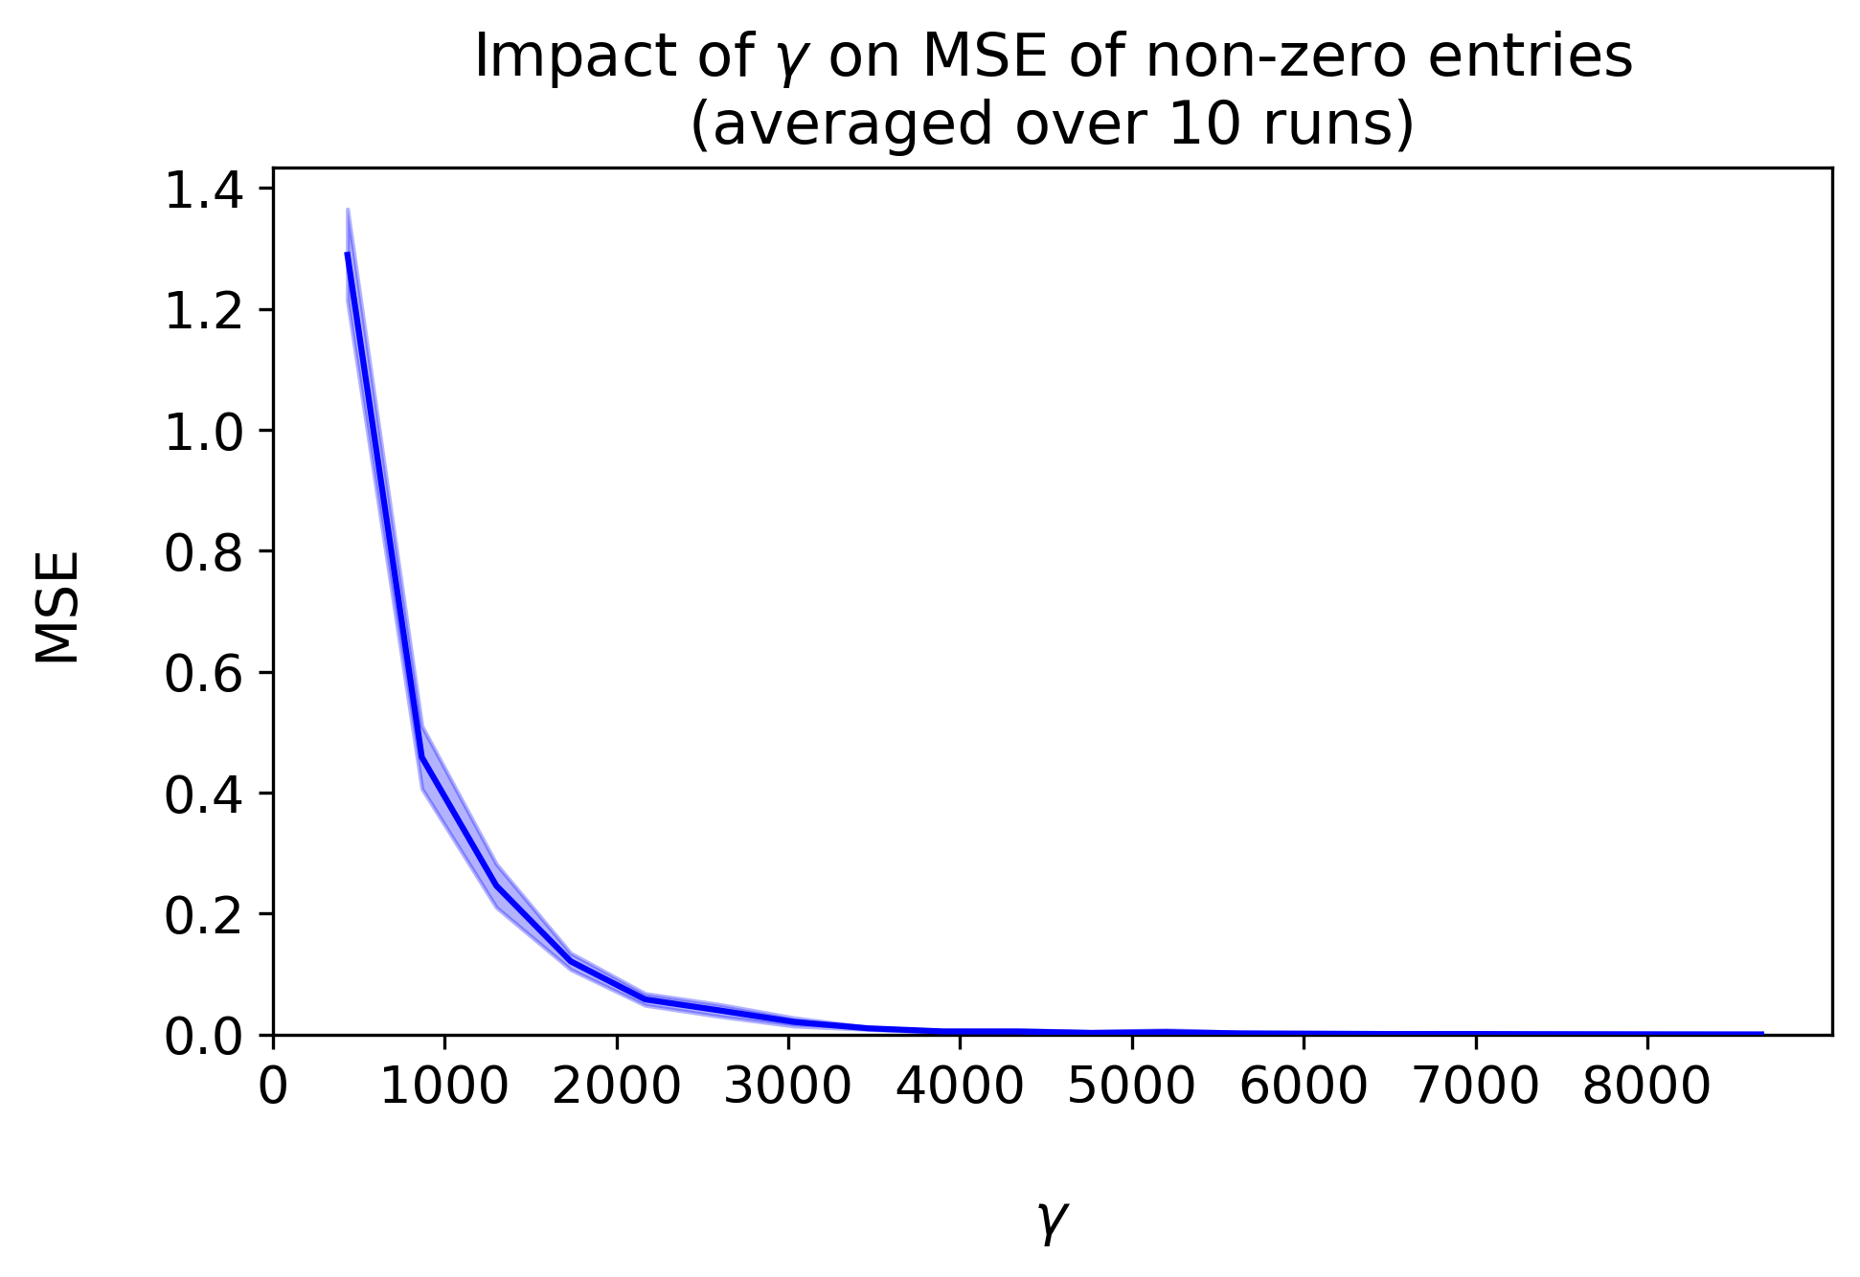
DIMSUM
Impact of γ
Notes:
If we compute the MSE only for non-zero entries however, we clearly see the same trend but with higher MSEs

Slide 14
Gradient descent with latent factors

Slide 15

Singular value decompositon
P^{T}
 | 1 | … | u | … | 480189
1
2
3
Latent factors
$A=UΣV^{T}=QP^{T}$
$Q=U$ : latent movie information
$P^{T}=ΣV^{T}$ : latent user information
$Q_{m}P_{u}^{T}$ : predicted rating for movie m by user u
Q |  | 1 | 2 | 3
 | 1
 | …
 | m
 | …
 | 17770
 | 1 | … | u | … | 480189
1 | 1 | 5 | 4
… |  | 2 | 1 |  | 2
m |  |  | 1
… | 3
17770 |  |  | 1
Notes:
We take the K largest latent (hidden factors) of the SVD decomposition of the MOVIES x USERS matrix
Q encodes latent movie information and PT latent user information
Multiplication of row m from Q with column u from PT gives a prediction for the rating of movie m by user u. In this example K=3 (we use 3 latent factors)
Now A is sparse so a lot of ratings are missing so this Q and P will currently be badly generalizable but we can iteratively refine them with a gradient descent approach

Slide 16
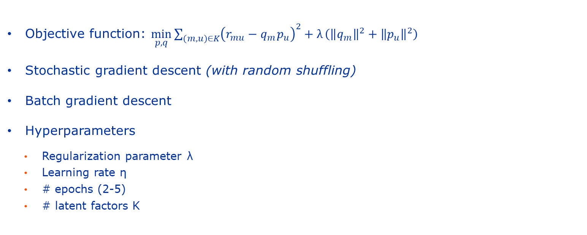
Gradient descent
Iterative refinement
Objective function: $\min_{p,q}{\sum_{(m,u)∈K}{{\left(r_{mu}−q_{m}^{}p_{u}\right)}^{2}+λ}\left({\left\|q_{m}\right\|}^{2}+{\left\|p_{u}\right\|}^{2}\right)}$
Stochastic gradient descent (with random shuffling)
Batch gradient descent
Hyperparameters
Regularization parameter λ
Learning rate η
# epochs (2-5)
# latent factors K
Notes:
Our gradient descent approach was based on this objective function composed of the prediction error and a regularization term (making sure qm and pu isn’t too big in regions with little information, i.e. prevent overfitting)
We will compare two approaches, namely
SGD which has frequent updates (one after each sample, i.e. based on gradient estimates) and which we performed with random shuffling
BGD which has less updates but more stable ones generally as they’re based on all samples (i.e. based on real gradients)
We have 4 main hyperparameters that we tuned somewhat on multiple small subsets of the dataset:
Regularization parameter
Learning rate
Number of epochs (which we kept relatively small for the sake of computation time)
Number of singular values we kept with SVD (or the number of latent factors): the largest latent factors are expected to contain the most important information and can therefore be seen as a more compressed representation of A. Changing “the compression rate” can ofcourse be expected to influence the performance. This is the first thing we’ll check out.

Slide 17
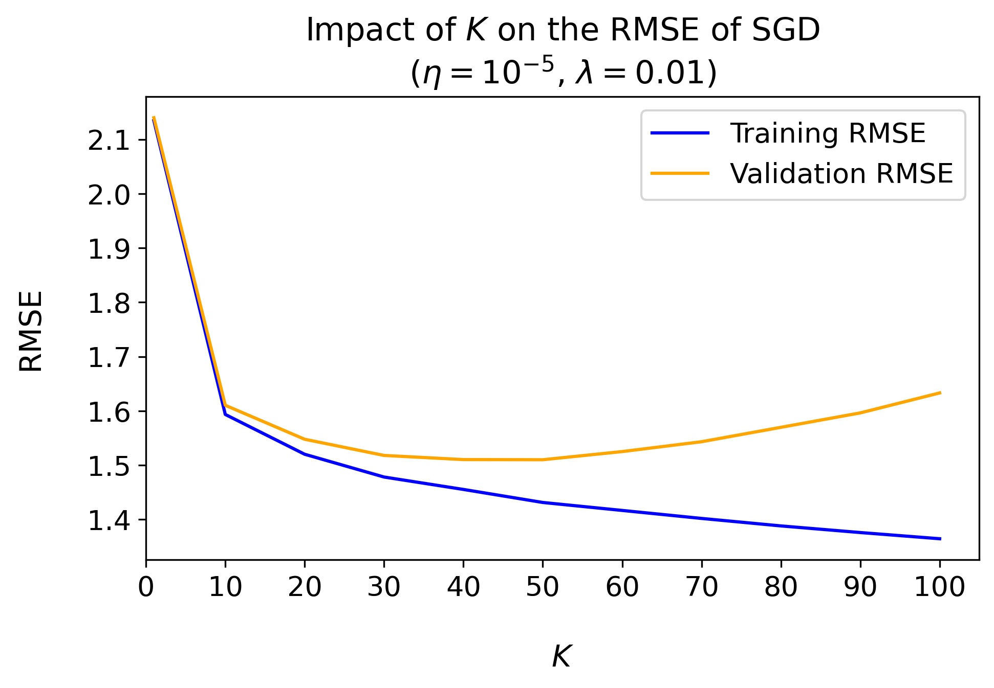
Stochastic gradient descent
Impact of K
Notes:
So first the impact of K on the RMSE of SGD.
We used a fixed learning rate 1e-5 and lambda of 0.01 and varied K from 1 to 100. This analysis was done based on an 80-20 train-test split of the probe training data (as we still saw it partly as tuning the hyperparameters and didn’t want to affect the final experiment with our probe test set).
Both in-sample and out-sample initially decrease. This is normal since having too few latent factors means we have too little information to learn a useful pattern in the training data. However, at some point we extract too many latent factors and learn the noise in the training data leading to bad generalization and diverging training and validation RMSE (i.e. overfitting) We clearly see the RMSE on the validation set rise again for K>50.

Slide 18
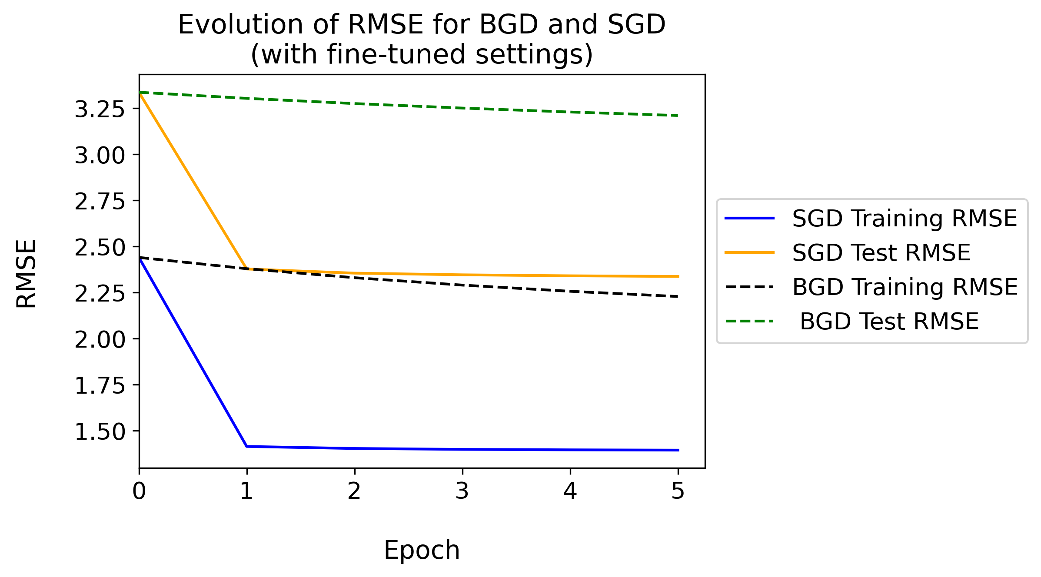
gradient descent
Comparison of SGD and BGD
Hyperparameters
K = 50
λ = 0.01
SGD: η = 10⁻⁵
BGD: η = 0.1/|dataset|
Notes:
Hyperparameters K and lambda could be kept fixed for both gradient descent approaches, but different learning rates were needed.
SGD could use the same learning rate of 1e-5 like in the previous experiment. Smaller learning rates are used since updates are based on gradient estimates which could sometimes be wrong. This can help escape local minima, but still we don’t want too significant deviations in the learning process.
We see a quick decrease and near-convergence after only 1 epoch. It should be noted this means around 100 million updates have occurred at that point.
BGD normally uses a larger learning rate since we use the real gradient (computed over all samples) and can only perform one update per epoch. However, even a learning rate of 1e-5 led to very large updates (even with other hyperparameters being tuned and data scaling). This did not only lead to overshooting but actually a sequence of overcorrecting steps and divergence.
Since the size of the dataset can definitely influence the gradient sum over the samples, we tried to mitigate the issue by taking the the gradient average over all samples instead of the gradient sum. This seemed to lead to more stable behavior, although learning is very slow this way as in effect we’re substantially lowering the learning rate (by dividing it by a large constant).
Either way, we see a fine-tuned SGD outperforms a fine-tuned BGD. This is mostly caused here by the learning rate, but nevertheless this is what is expected. SGD can perform more updates in the same number of passes over the data which generally leads to quicker convergence than BGD. This makes SGD a better candidate for learning in a setting with large datasets.

Slide 19
references
bibliography
[1] BellKor’s Pragmatic Chaos Wins $1 Million Netflix Prize by Mere Minutes. (2009). Retrieved May 31, 2022, from https://www.wired.com/2009/09/bellkors-pragmatic-chaos-wins-1-million-netflix-prize
[2] Zadeh, R. B., & Carlsson, G. (2013). Dimension independent matrix square using mapreduce. arXiv preprint arXiv:1304.1467.
[3] Koren, Y., Bell, R., & Volinsky, C. (2009). Matrix factorization techniques for recommender systems. Computer, 42(8), 30–37.

Slide 20
Questions?

